Slide 1
SPAM|HAM
SC1015 DSAI Mini Project SC7 Group 11
Classification
Rayden Teo, Jerome Wang

Slide 2
Spam vs Ham
So What…
Is Spam and Ham?

Slide 3

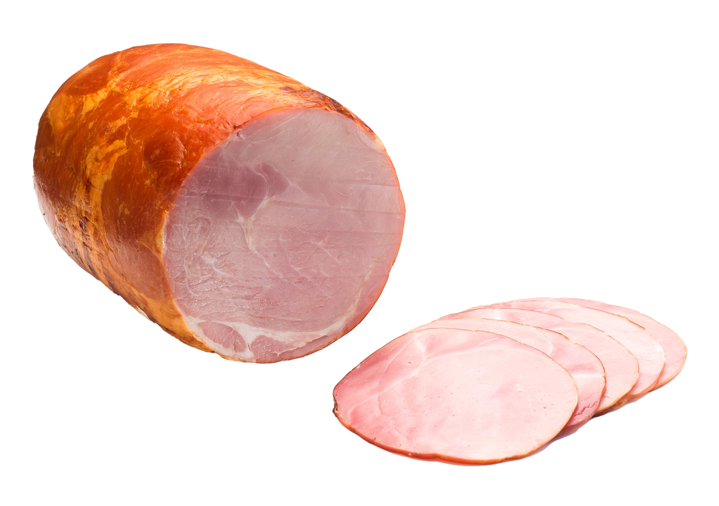
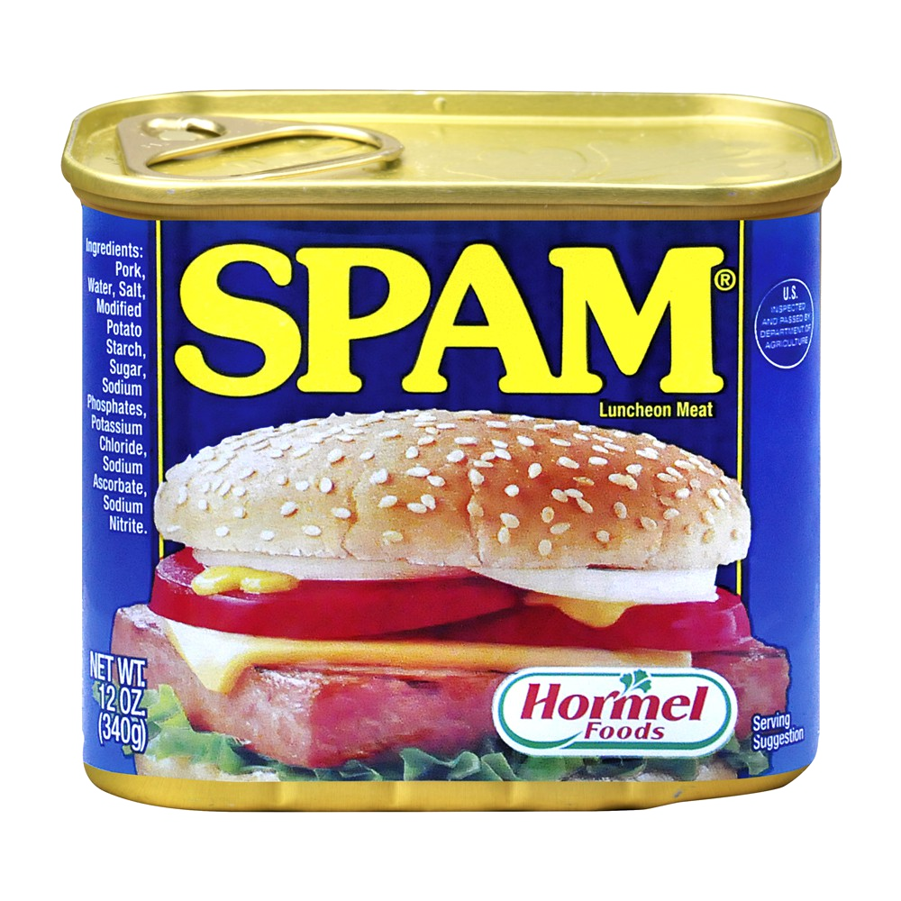
Spam vs Ham
So What…
Is Spam and Ham?

Slide 4
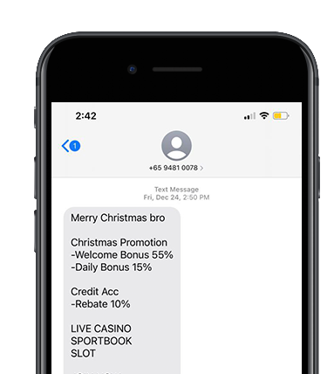
Spam vs Ham
Now, this is a spam message

Slide 5
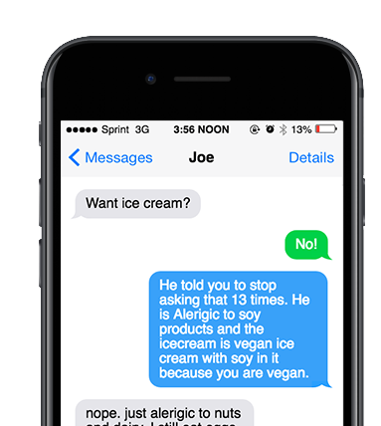
Spam vs Ham
Now, this is a HAM message

Slide 6
But why a spam classifier?
Project Motivation
Now, this is a HAM message

Slide 7
But why a spam classifier?
Project Motivation
SPAM MSGS UP BY
7.1 BILLION
DURING THE COVID-19 PANDEMIC

Slide 8
Problem Statement
But why a spam classifier?
SPAM MSGS UP BY
7.1 BILLION
DURING THE COVID-19 PANDEMIC
How do we differentiate Ham from Spam messages?

Slide 9

Dataset Background
Published at:
UCI Machine Learning Repository
Sources:
Grumbletext, NUS SMS Corpus, Caroline Tag’s PHD Thesis, SMS Spam Corpus v0.1 Big
Date of Publication:
2012
SMS Spam Collection Data Set

Slide 10
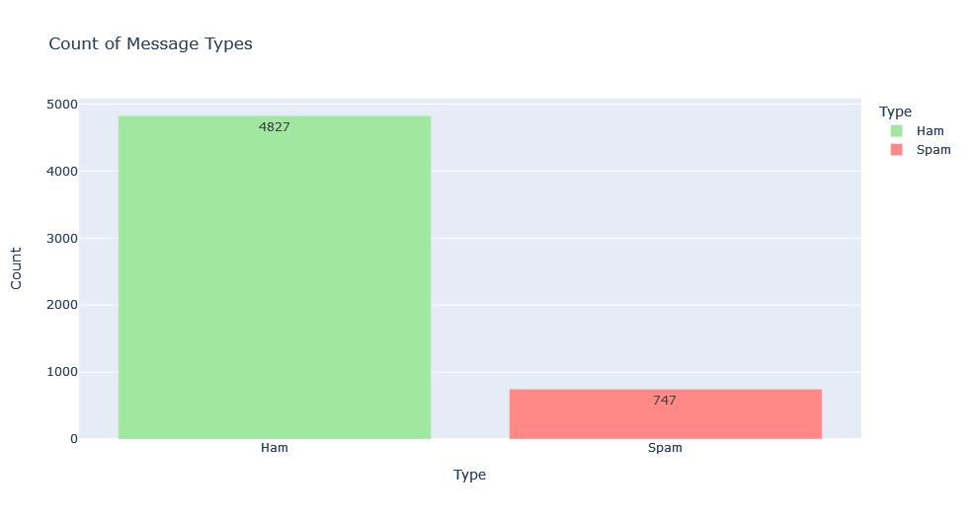
EDA | Class Imbalance

Slide 11
Feature Engineering | Tokenization by Words
Yep, at derek's house now, see you Sunday <3

Slide 12
Feature Engineering | Tokenization by Words
1
2
3
4
5
6
Yep
,
at
derek’s
house
now
7
8
9
10
11
,
see
you
Sunday
<3
Total Word Count: 11
Note: We have included punctuation in word count as we believe that punctuations differ between spam and ham

Slide 13
Sample Data
Yep, at derek's house now, see you Sunday &lt;3

Slide 14
Sample Data
Yep, at derek's house now, see you Sunday &lt;3

Slide 15
Sample Data
Yep, at derek's house now, see you Sunday <3

Slide 16
Data Cleaning
Characters / Symbols | Meaning
&lt; | <
&gt; | >
&lt;#gt; | numbers
&lt;DECIMAL&gt; | decimal
&lt;URL&gt; | url
&lt;TIME&gt; | time
&lt;EMAIL&gt; | email
Â ’ | ‘
Ü/ü | U/u
&amp | &
STS, CCH, SPA | Unknown (to be removed)
!鈥┾??〨 | unknown (Probably an Emoji, should be irrelevant so we will leave it as unknown)

Slide 17
Feature Engineering | Tokenization by Words
Go until jurong point, crazy.. Available only in bugis n great world la e buffet... Cine there got amore wat...

Slide 18
Feature Engineering | Tokenization by Words
Typo
Go until jurong point, crazy.. Available only in bugis n great world la e buffet... Cine there got amore wat...

Slide 19
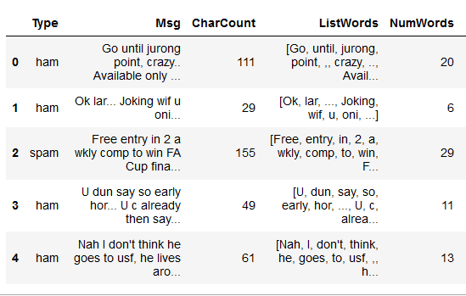
Feature Engineering | Tokenization by Words
Typo
Go until jurong point, crazy.. Available only in bugis n great world la e buffet... Cine there got amore wat...

Slide 20
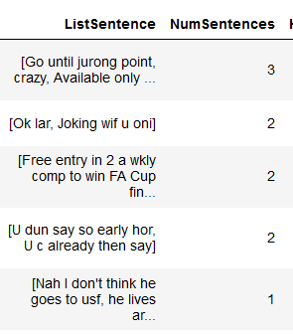
Feature Engineering | Tokenization by Sentences

Slide 21
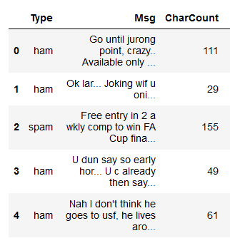
Feature Engineering | Char Count

Slide 22
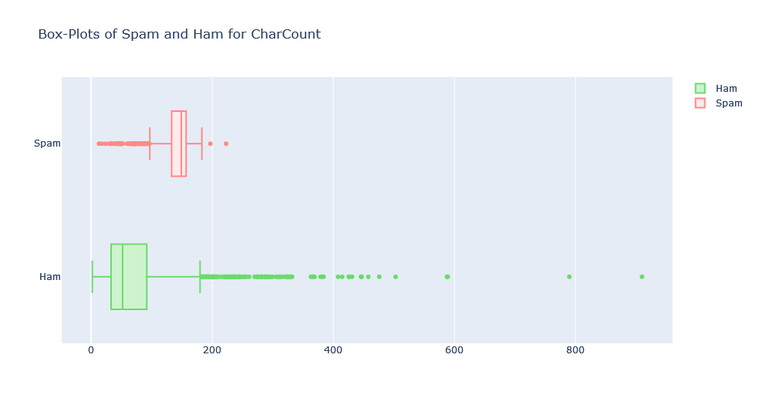
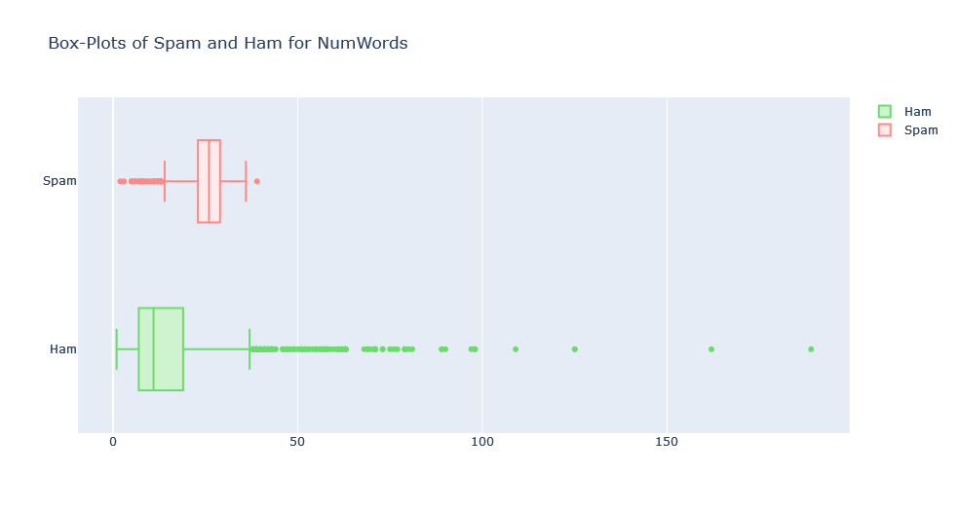
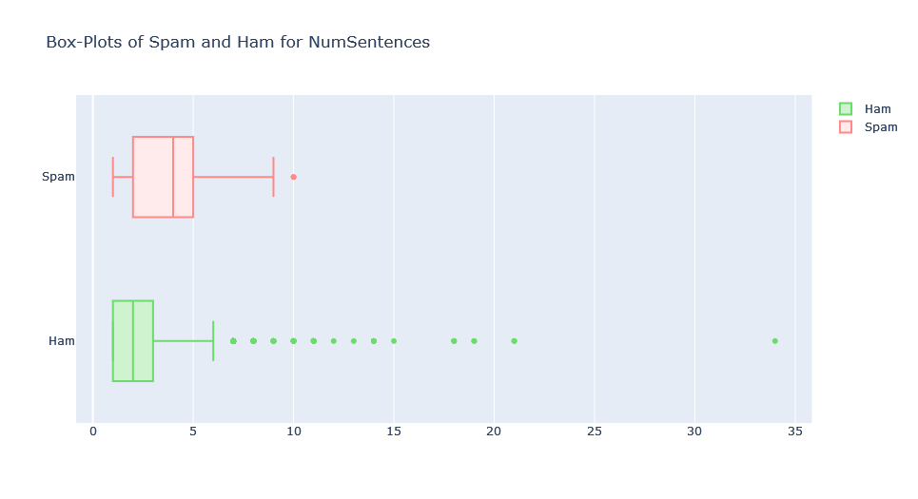
EDA | Box Plot – 3 Features

Slide 23
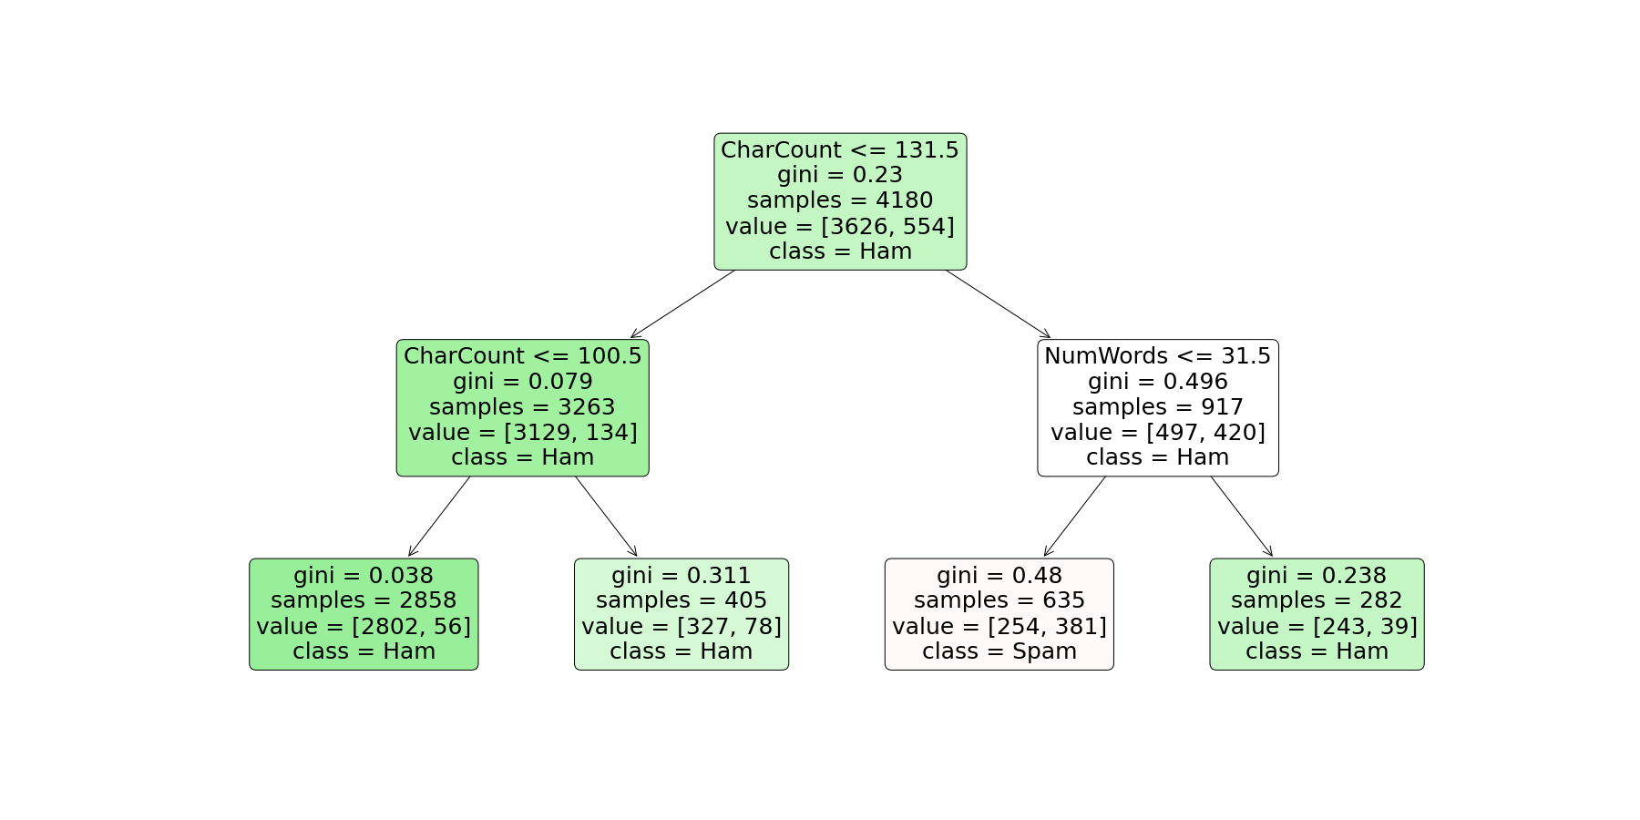
Binary Decision Tree | Depth 2
Depth 2

Slide 24
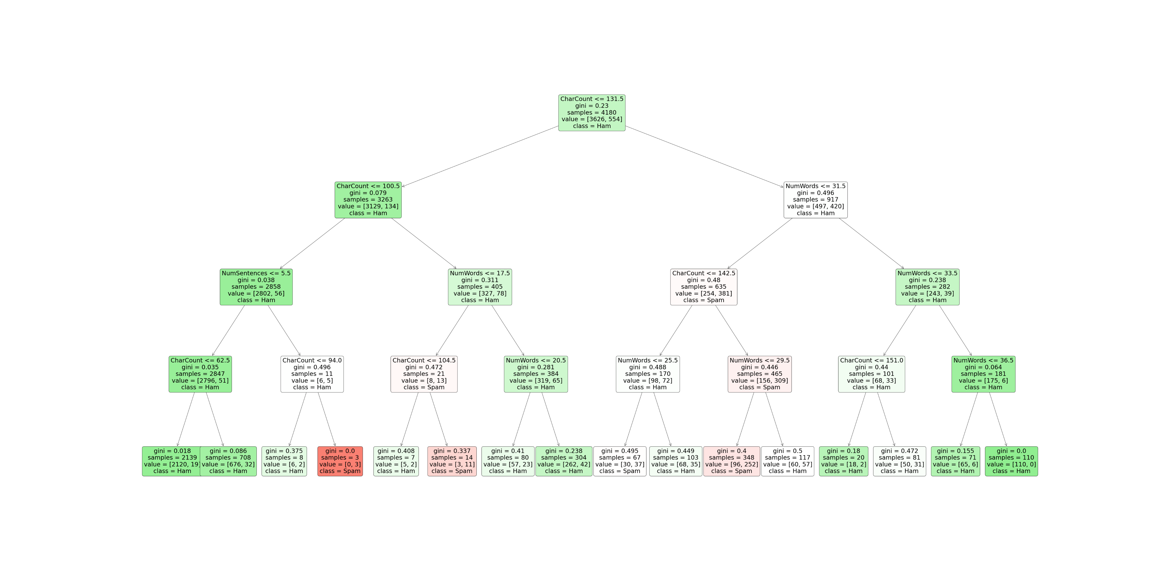
Binary Decision Tree | Depth 4
Depth 4
Note: Charts for depths > 4 are not generated due to space constraint

Slide 25
Binary Decision Tree | Depth 4
Depth | Classification Accuracy | Val Classification Accuracy
2 | 0.8978468899521531 | 0.9031563845050216
4 | 0.9090909090909091 | 0.906025824964132
6 | 0.9169856459330143 | 0.9010043041606887
10 | 0.9485645933014354 | 0.900286944045911
Increase in Classification Accuracy
Overfitting

Slide 26

Binary Decision Tree | Class Imbalance
Model Score
Classification Accuracy
Class Imbalance
Precision
Recall

Slide 27
Binary Decision Tree | Class Imbalance
Model Score
Classification Accuracy
Class Imbalance
90.60%
Precision
F1 Score
Recall
33.83%

Slide 28
NLP | Background
Yep
,
at
derek’s
house
now
,
see
you
Sunday
<3

Slide 29

NLP | Background
Context: Where
Yep
,
at
derek’s
house
now
,
see
you
Sunday
<3

Slide 30
NLP | Background
Context: When
Context: Where
Yep
,
at
derek’s
house
now
,
see
you
Sunday
<3

Slide 31
NLP | Background
Context: When
Context: Where
Yep
,
at
derek’s
house
now
Context: Who
,
see
you
Sunday
<3

Slide 32
NLP | Background
Context: When
Context: Where
Yep
,
at
derek’s
house
now
Context: Who
,
see
you
Sunday
<3
Context: When

Slide 33
NLP | Background
Sentence Structure
Context: When
Context: Where
Yep
,
at
derek’s
house
now
Context: Who
,
see
you
Sunday
<3
Sentence Structure
Context: When

Slide 34
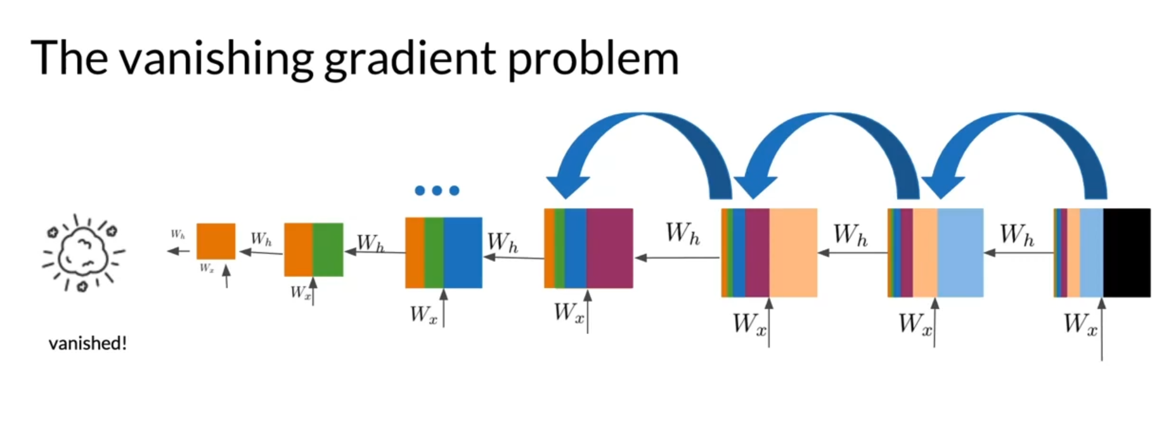
NLP | RNN
No Learning Occurs!!!
Image from DeepLearning.Ai

Slide 35
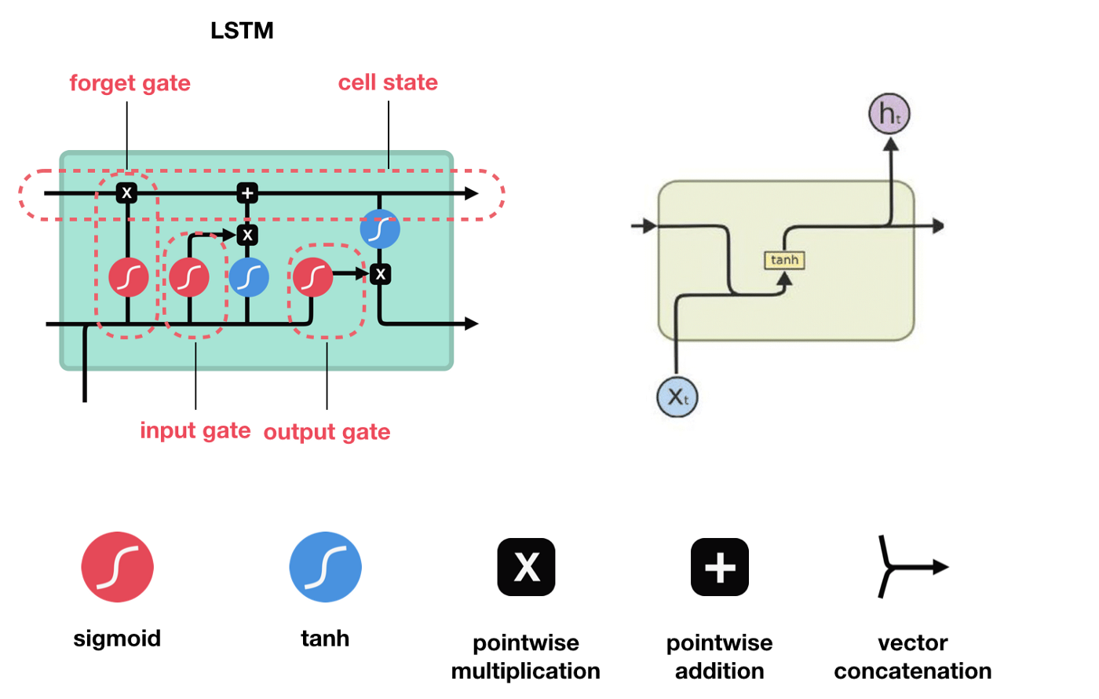
NLP | LSTM
RNN
Image adapted from ResearchGate and towardsdatascience

Slide 36
NLP | LSTM
RNN
Image adapted from ResearchGate and towardsdatascience

Slide 37
NLP | LSTM
RNN
Image adapted from ResearchGate and towardsdatascience

Slide 38
NLP | LSTM: Structure
How are you
Messages

Slide 39
NLP | LSTM: Structure
Pre-Processing
How are you
Messages

Slide 40
NLP | LSTM: Structure
3
How are you
Messages
2
1

Slide 41
NLP | LSTM: Structure
3
Message
Input Layer
Messages
2
1

Slide 42
NLP | LSTM: Structure
3
Pre-Processing
Message
Messages
2
1

Slide 43
NLP | LSTM: Structure
3
Pre-Processing
Embedding Layer
Message
Messages
2
1

Slide 44
NLP | LSTM: Structure
0.113, 0.927
Input Layer
LSTM Layer
Pre-Processing
Message
Messages
0.264, 0.581….
0.827, 0.237….

Slide 45
NLP | LSTM: Structure
LSTM CELL
LSTM CELL
Embedding Layer
Input Layer
…… …
Pre-Processing
Message
Messages
LSTM CELL
LSTM CELL

Slide 46
NLP | LSTM: Structure
LSTM CELL
LSTM CELL
Embedding Layer
…… …
Input Layer
Dropout Layer
Pre-Processing
Message
Messages
LSTM CELL
LSTM CELL

Slide 47
NLP | LSTM: Structure
Embedding Layer
LSTM Layer
Input Layer
Dropout Layer
Pre-Processing
Dense (Output layer)
Message
Messages

Slide 48
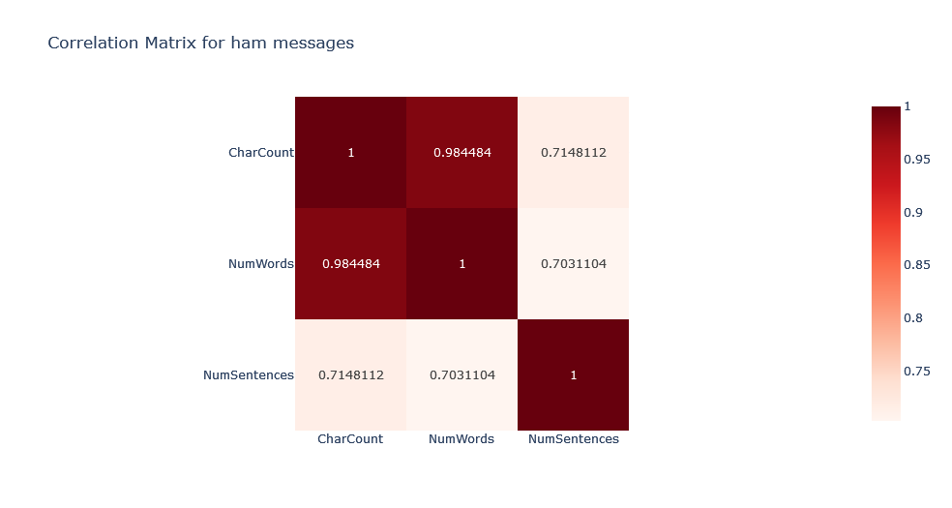

NLP | LSTM: Tokenization
Note:
we will not be removing stopwords as we believe that doing so will negatively impact our LSTM model’s ability to comprehend context

Slide 49
NLP | LSTM: One-Hot Encoding
Ok
lar
Joking
wif
u
oni
24
25
26
27
28
29

Slide 50
NLP | LSTM: Padding
24
25
26
27
28
29
…
0
0
24
25
26
27
28
29

Slide 51
NLP | LSTM: Vectorization
24
25
26
27
28
29
…
0
0
25
26
27
28
29
-0.283, 0.8267, 0.2645, 0.9823…
Each word is converted into a vector (array of numbers) using pre-trained GloVe embeddings fed into the embedding layer

Slide 52
NLP | LSTM: Model Tuning
Example: Optimizer Tuning
Optimizer | Val F1 Value
Adadelta | 0.7609897256
Adagrad | 0.8570520878
Adam | 0.9621301889
RMSprop | 0.9724422097
SGD | 0.8568769097

Slide 53
NLP | LSTM: Model Tuning
Best Parameters to use
Parameter | Value
GloVe Embedding Size | 300
Optimizer | RMSprop
Loss Function | categorical crossentropy
Number of epochs | 17

Slide 54
NLP | LSTM: Outcome
For LSTM
Scoring System | Value
Accuracy | 0.9734576941
Precision | 0.9707351923
Recall | 0.9756097794
F1 | 0.9730702043
Classification Tree
Scoring System | Value
Accuracy | 0.9060258249
F1 | 0.3383892932

Slide 55
NLP | LSTM: Outcome
Real life testing: Examples
Type | Predicted | Msg
Spam | Ham | Your account is temporarily frozen. Please log in to to secure your account
Spam | Spam | You won a prize of 1,000$, click here to claim!
Spam | Ham | Beautiful weekend coming up. Wanna go out? Sophie gave me your number. Check out my profile here: bit.ly/profileGB12RD
Spam | Ham | Dear customer, Bank of America is closing your bank account. Please confirm your PIN at notbankofamerica.com/XJY23VB to keep your account activated.
Spam | Spam | You've won a prize! Go to bit.ly/yourprize001 to claim your $500 Amazon gift card
Ham | Ham | The article was published on 18th August itself
Ham | Ham | Although we are unable to give you an exact time-frame at the moment, I would request you to stay tuned for any updates.
Ham | Ham | The image you sent is a UI bug, I can check that your article is marked as regular and is not in the monetization program.

Slide 56
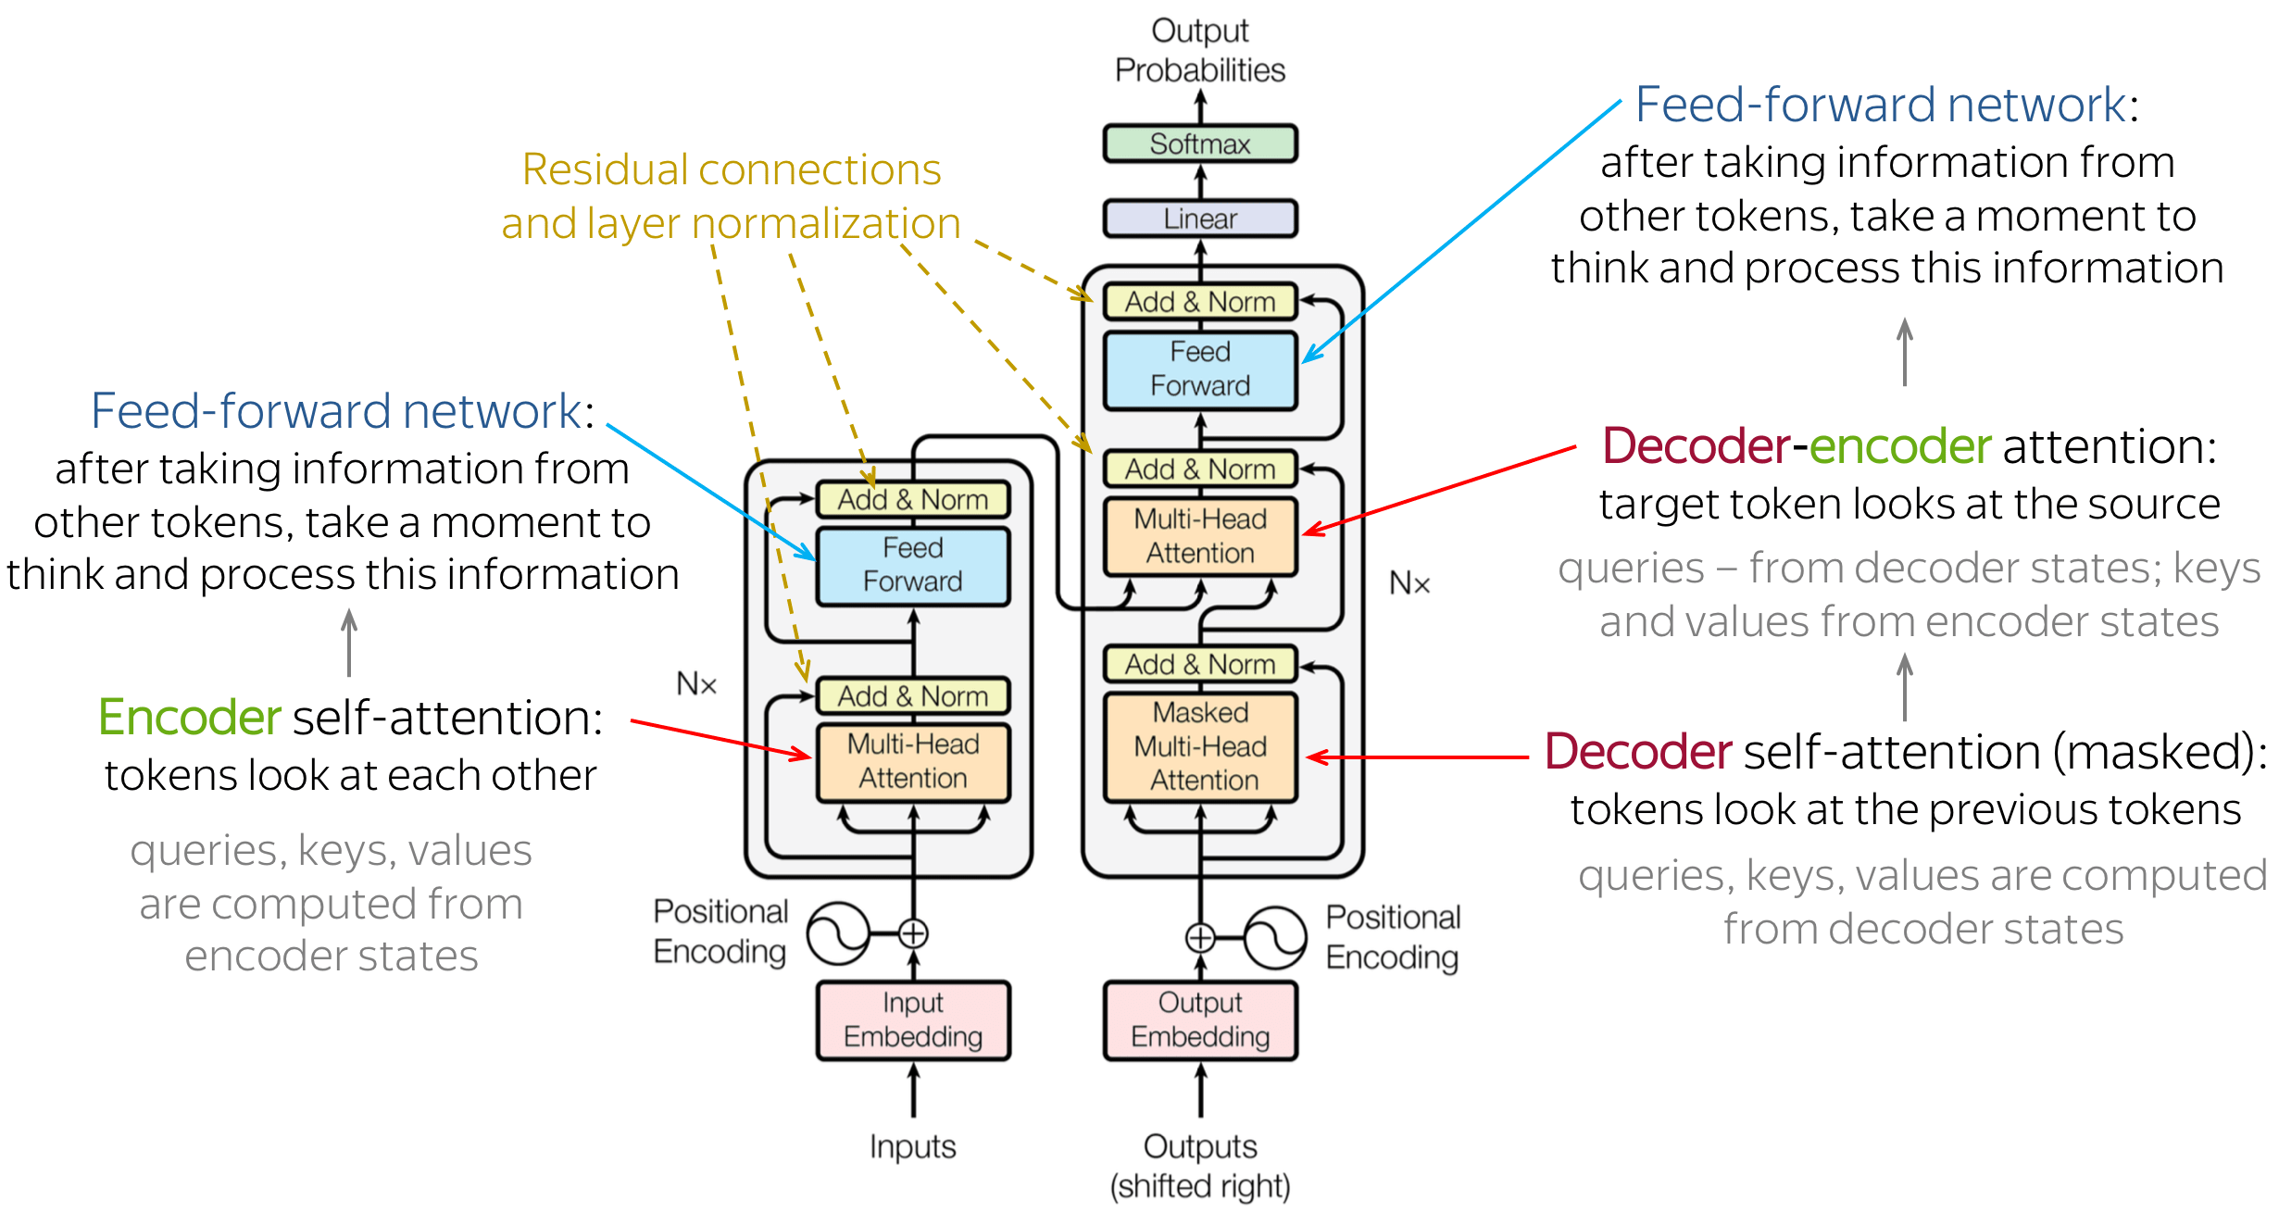
NLP | LSTM: Recommendation
Image derived from StackExchange

